Slide 1
POKING THE WHALE
Docker Crash Course
By Łukasz Bielenin

Slide 2
AGENDA
What is Docker?
Why Docker?
​Basic Docker commands
Resources
Dockerfile
Networking
Configuration
Volumes
Docker-compose
​

Slide 3
Introduction
- Docker is technology that enables running application in containers
„Containers” basically means isolated units of work, similar to virtual machines, but they are not emulating particular CPU or RAM, only operating systems
By default, linux container run on UNIX based systems, like Ubuntu or Debian
There’s also Windows based containers, but they are far less common
In Windows, Docker runs on WSL

Slide 4
Why docker?
Docker container provide isolated enviroment, so you don’t have to worrry about stuff like dependencies, or Windows Update messing with your Erlang cookies (talking about you, RabbitMQ)
Through tools like docker-dompose provides easy way for running multiple apps at once
Personally, I took interest in Docker when I was helping testers team and needed solution for running multiple apps at once without worrying about appsetting and ports.

Slide 5
Basic docker commands
Syntax: „docker {resource} {action} {--args}
docker run {container} – running container
docker inspect – inspecting resource configuration
docker logs – checking container logs
docker prune {resouce} – removing not used resources
docker {resource} ls – listening resources
docker pull {resource} - pulling container
docker exec -it {container} {action} – execute action in container
docker rm {resource} – remove resource

Slide 6
Docker resources
Containers: context for running applications
Images: template for container
Networks: virtual networks that can be created for containers
Volumes: resources for data persistance

Slide 7
Dockerfile
Dockerfile is starting point for creating docker image
It’s being used for runing and/or building application as well as dependencies
Usually new dockerfile is created „from” some other image
Proper dockerfile should follow Shrek principle: it should have layers and every layer should be responsible for part of building process

Slide 8
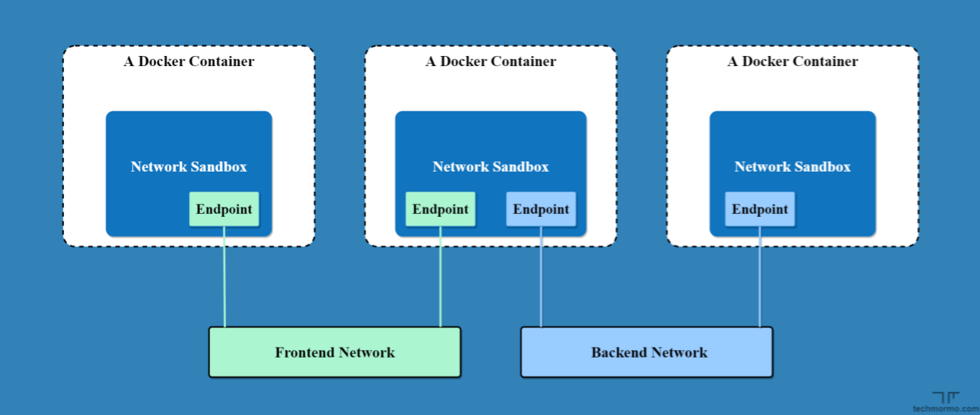
Networking
- By default, docker containers are isolated from local traffic and, in most cases, we should keep it that way
Docker networks are virtual networks that isolate containers and expose them only to endpoints that are really needed
One container can be connected to more than one network
Types of network
Bridge:standalone network with dns resoultion between containers
Host: no isolation
Overlay: connects multiple docker daemons together
None: disables networking
Macvlan: routes container by the MAC addresses
Ipvlan: network gives users total control of ipv4 and ipv6 addressing.

Slide 9
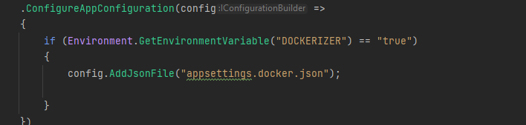
Configuration
Configs like connection strings differs from „localhost” variants due to container isolation
In case of user defined bridge network, the „name” property of container serves as endpoint of the container, which is super handy because you don’t have to connect with IP address
Main way for managing configuration of container is via environment variables
.NET applications read configuration from enviroment variables by default, some whole configuration can be freely mapped
Don’t do something like that XD:

Slide 10
Volumes
Whole data connected to container is gone as soon as container is disposed
The way to preserve data is to use bind mounts or volumes
Volumes is mechanism for persisting data and are being managed by docker,
Bind mounts are managed by folder structure in host computer, it’s kinda like folder mapping, handy when container has to read file are save file in host’s hard drive.

Slide 11
Healthchecks
Healtcheck are being used for checking if container is usable
Can be configured via docker command or in Dockerfile
Has following options:
Interval – how often container is being pinged
Timeout – after what time healthcheck fails
Start-Period - time after checking should start
Retries – number of healthcheck failures before container is deemed unhealthy
Healthchecks in docker are informational, but can be used for some other application

Slide 12
Docker compose
Great tool for configuring multiple containers
Basically encapsultes multiple docker commands in single yaml file
Can use environment variables
Basic commands:
docker-compose up
docker-comose down
docker-compose up –force-recreate – for forcing image rebuilding

Slide 13
Tips for headaches
Add „curl” and „bash” to your container, it may come in handy during network debugging
Using „docker exec –it <container name> <command line, like bash or sh>” enables to poke inside container for debugging purpouses, like connection or file resolving.
Ensure logging in every place that may connect to something else
Use external service like autoheal for controller health management
Linux container works with .NET 5+/.NET CORE, but netstandard nuget packages may crash.
Don’t use host network if you don’t have to
And, finally: use Docker when you NEED to. It has many perks, but configuring container can be tricky, especially in vpn and they are eating more resources than native apps.

Slide 14
THANK YOU

